Slide 1
Adaptive Beam Measurement
Master thesis research 2020
Boqiang Wang & Harshal Patal A
CSIM-FsUe Team A
2020-10-30

Slide 2
Content
3GPP Baseline
Objective
Method
Simulation
Result

Slide 3
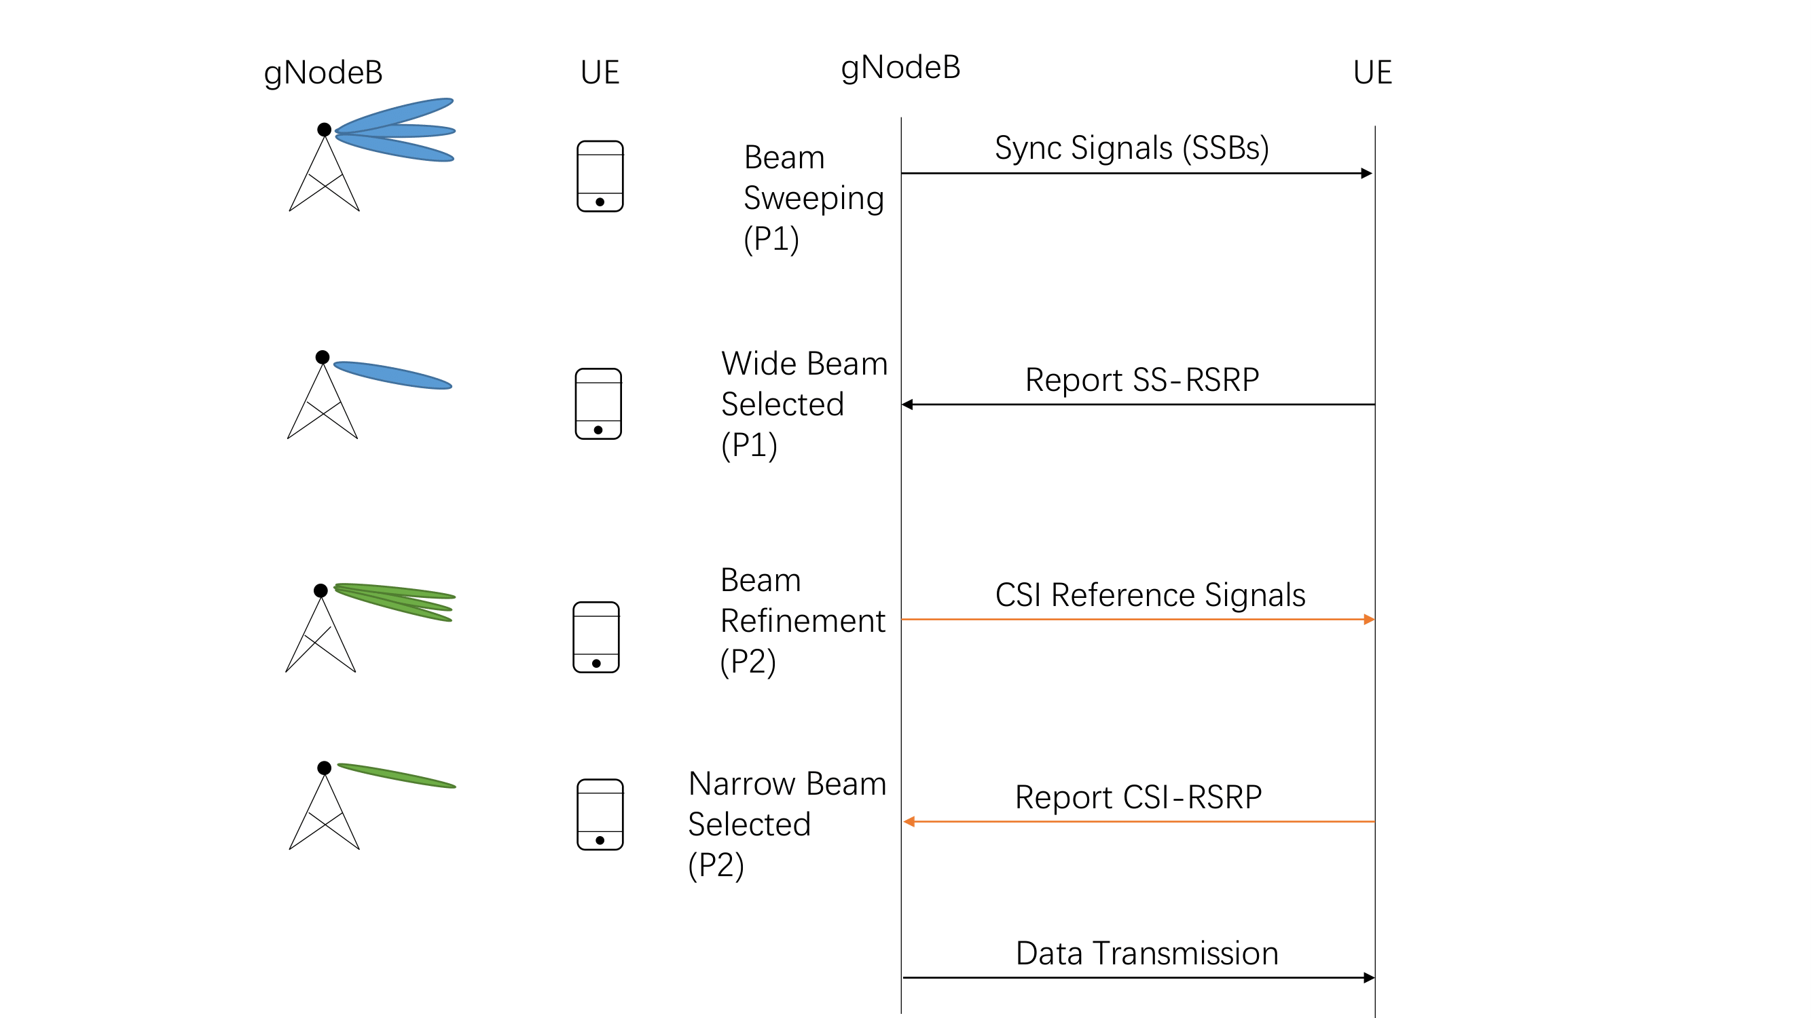
3GPP Baseline

Slide 4
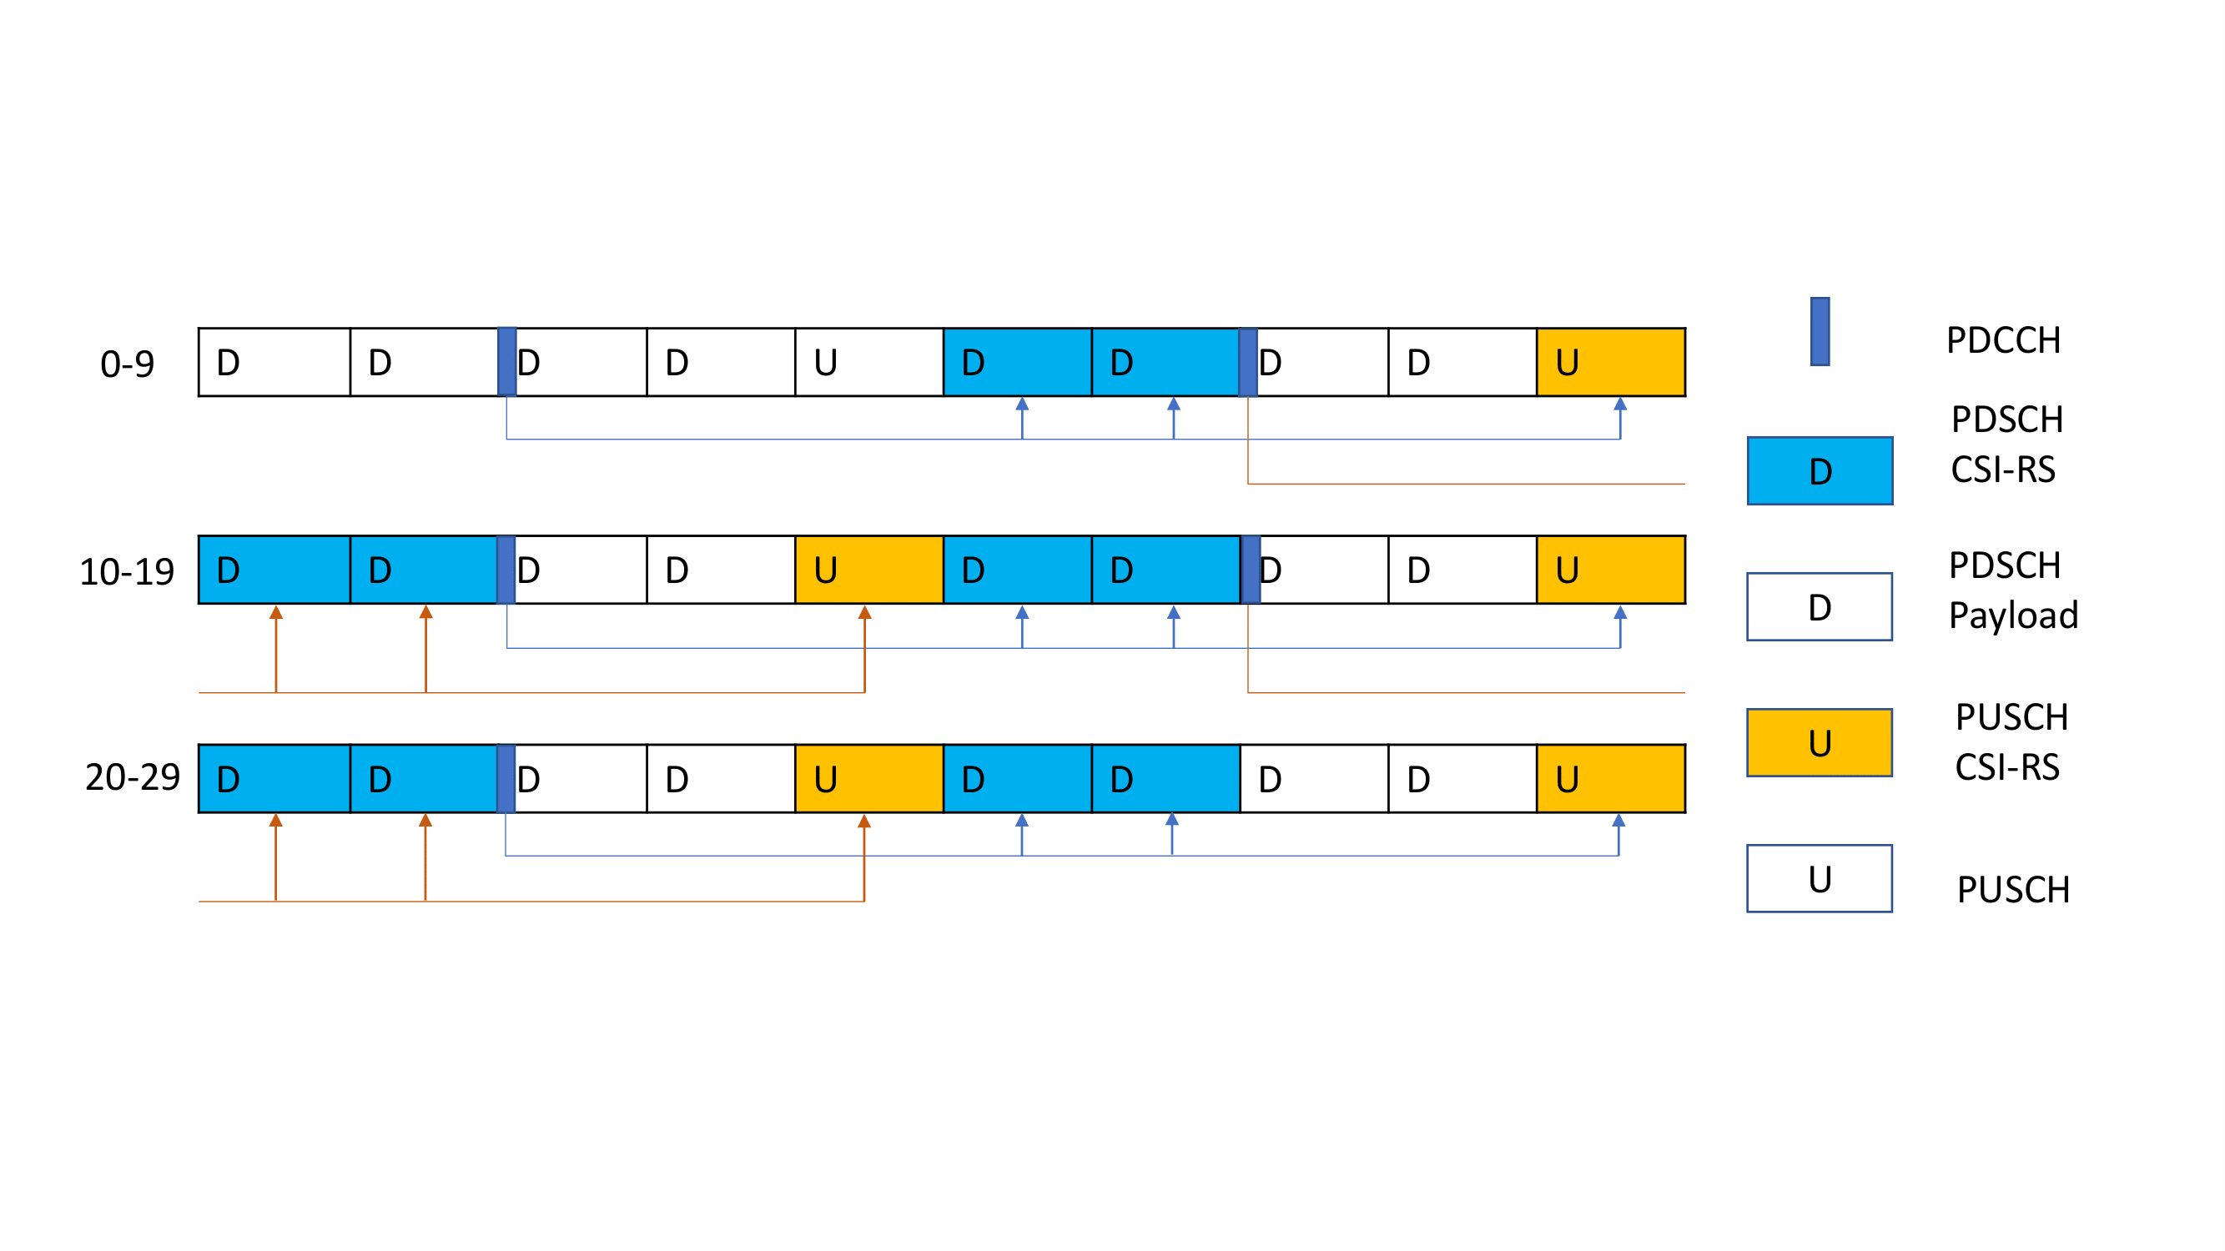
3GPP Baseline
TDD 4-1 Pattern

Slide 5
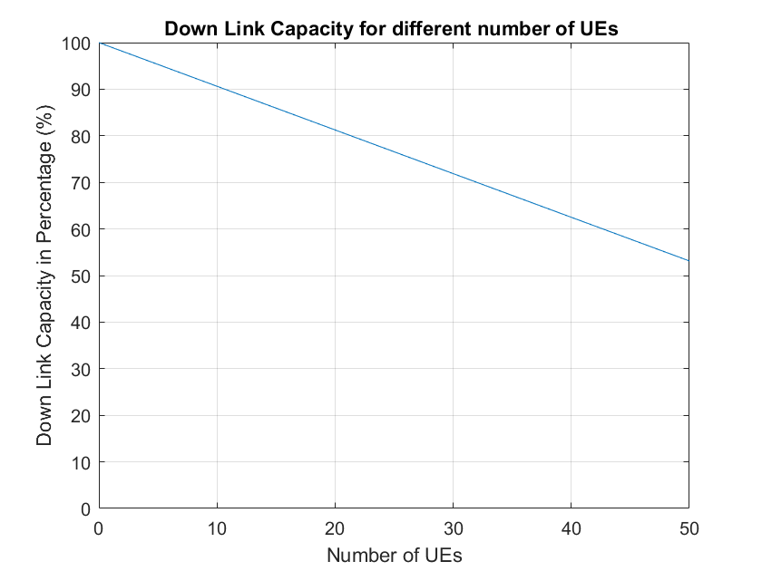
3GPP Baseline

Slide 6
Objective
Beam management consumes a lot of resources
Try another approach compare to 3GPP baseline by using machine learning

Slide 7
Method overview
Data collection using baseline algorithm in simulator
Train and evaluate ML algorithms offline
Integrate the prediction function for the 2 best algorithms into the simulator
Run simulations and collect KPIs

Slide 8
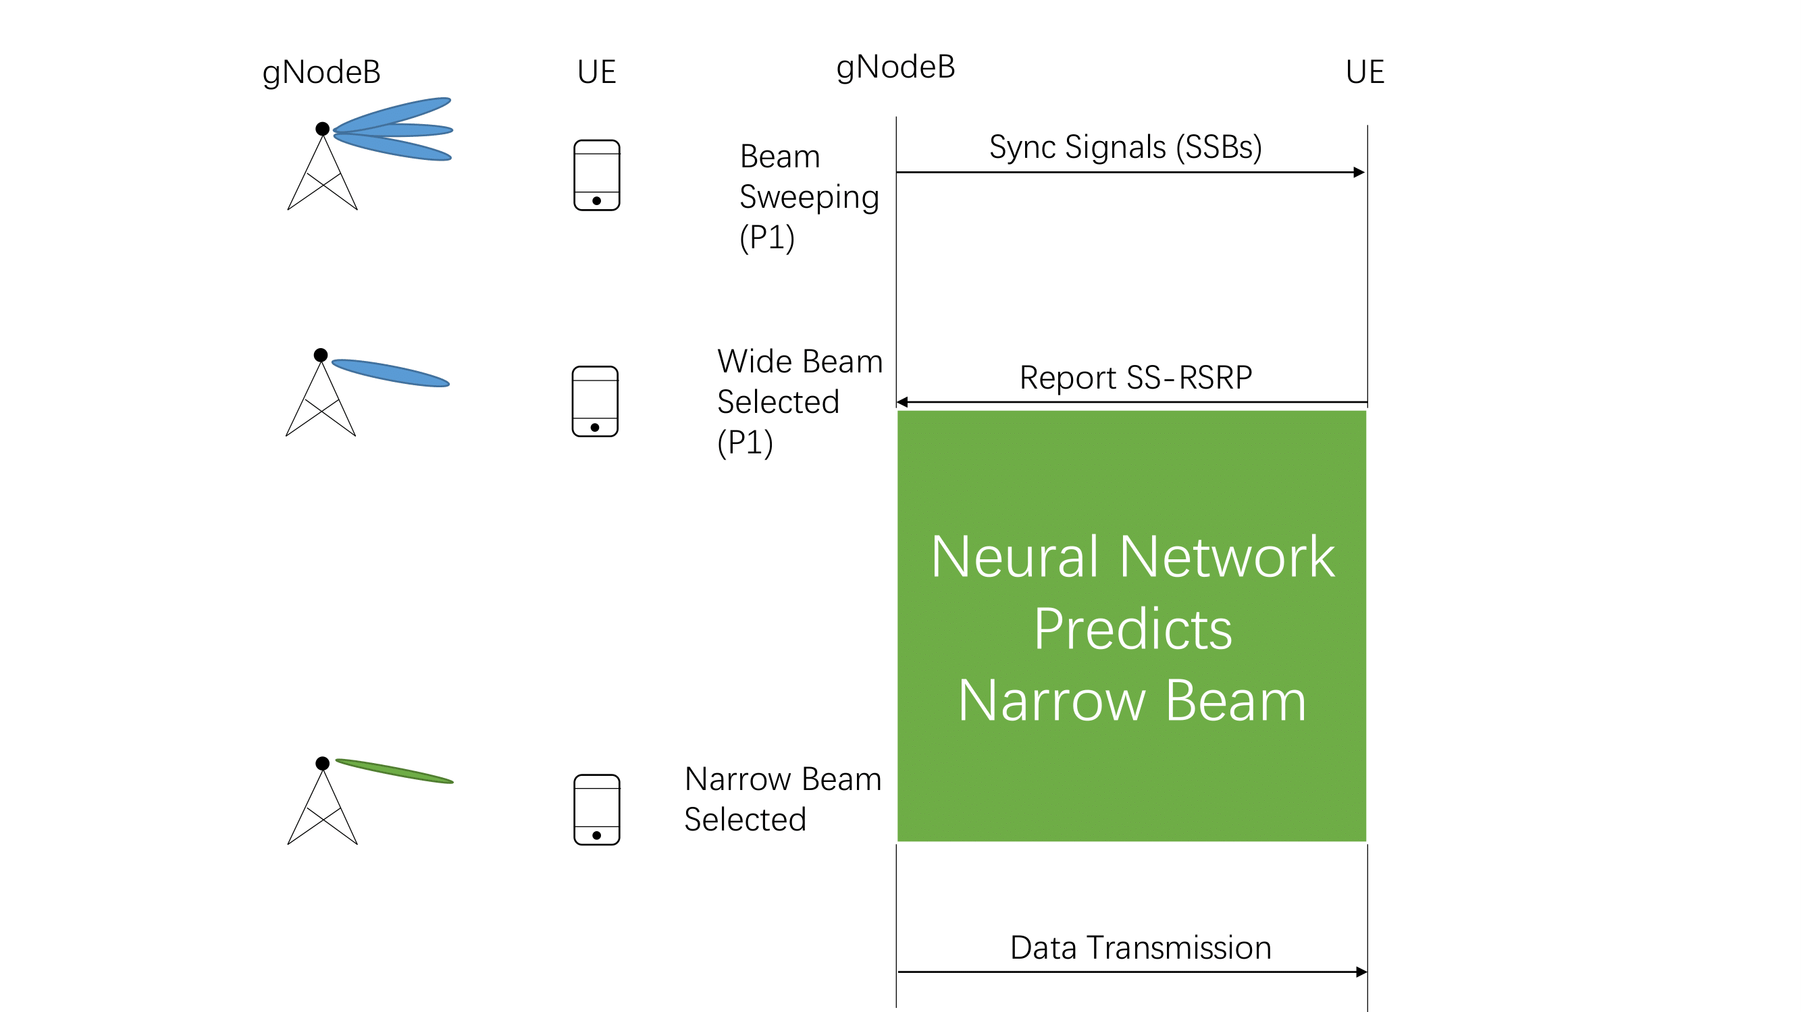
Method

Slide 9
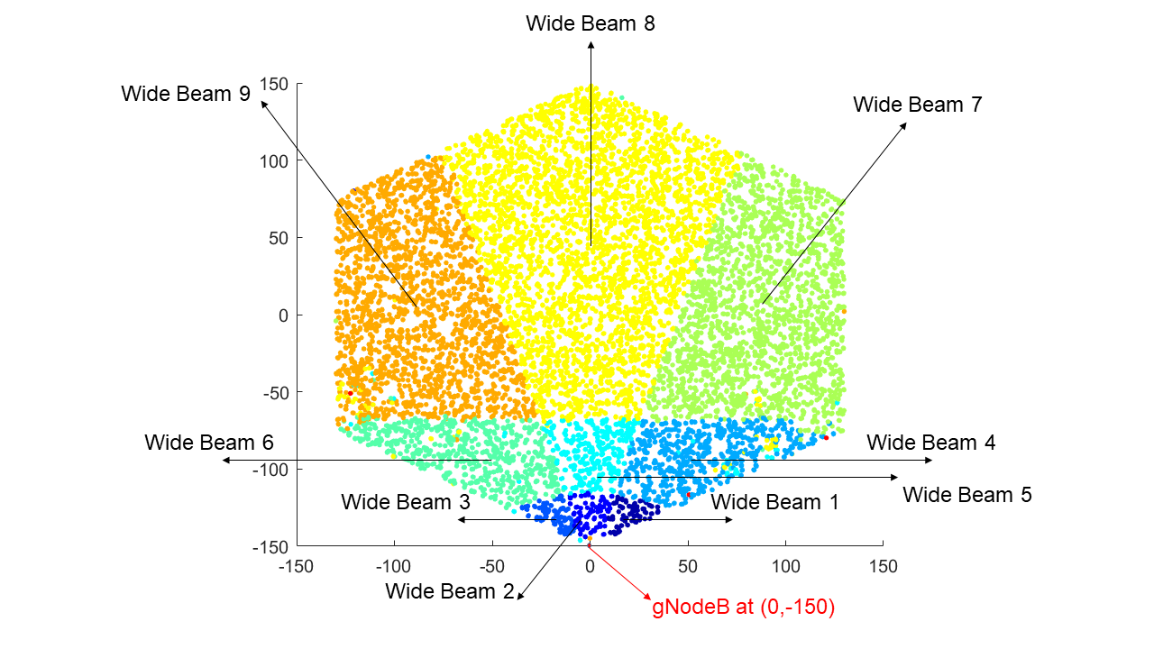
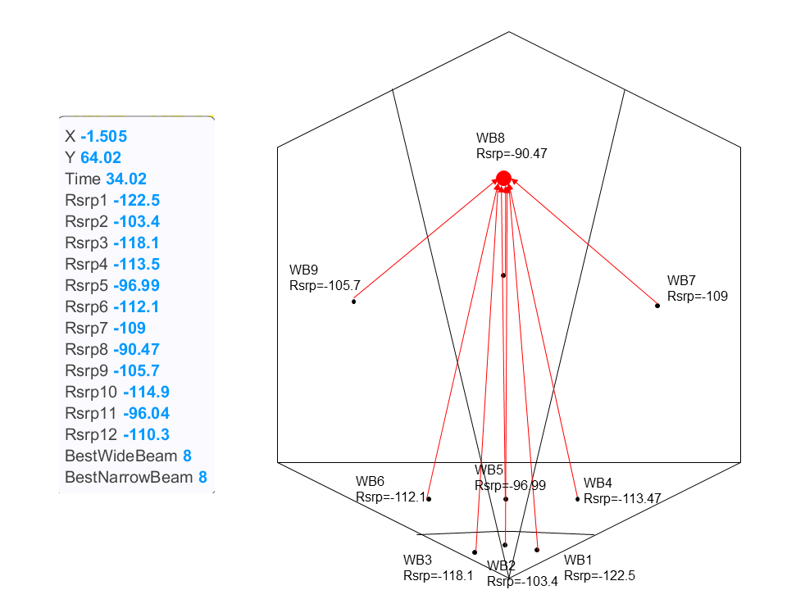
Method

Slide 10
Method
Machine Learning Algorithms Training:
12 SSB RSRP values
Angle of Arrival (2.5-degree accuracy from Product Implementation)
Timing Advance (9.8 meters accuracy from 3GPP)
4. Narrow beam index

Slide 11
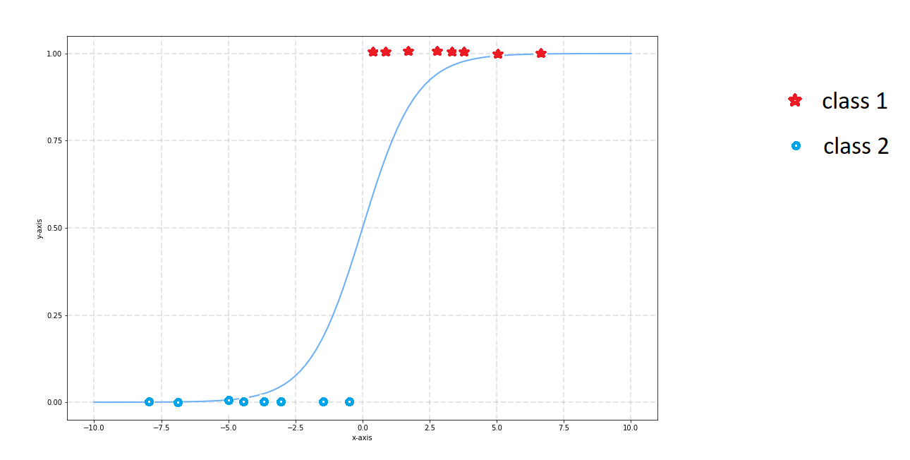
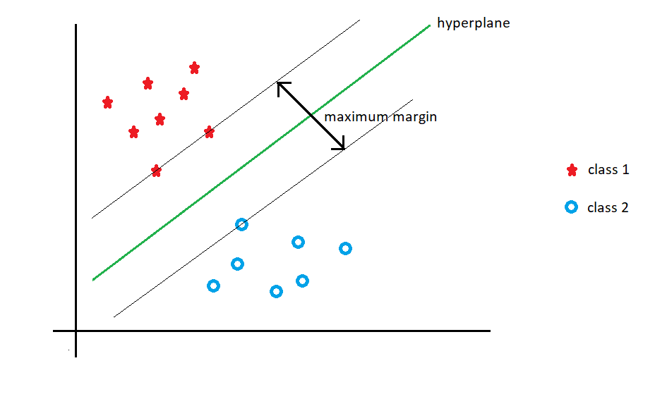
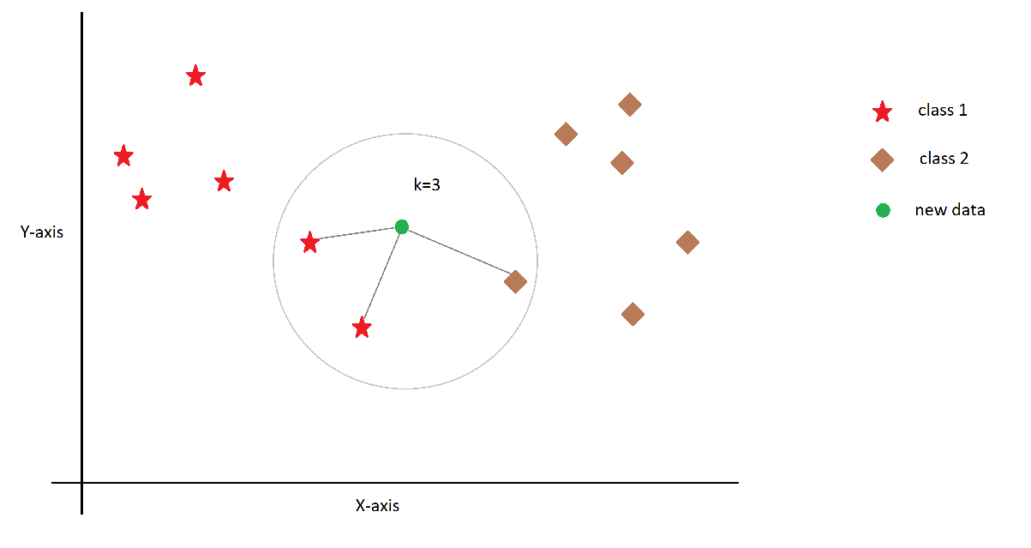
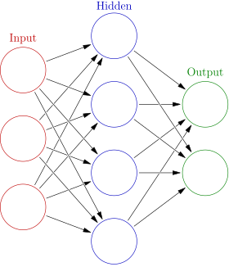
Methods explored in offline analysis
Support Vector Machines (SVM)
Accuracy : 80%
Logistic Regression (LR)
Accuracy : 65%
K-Nearest Neighbor (KNN)
Accuracy : 71%
Neural Network (NN)
Accuracy : 80%

Slide 12
Limitation
Line of Sight (LoS)

Slide 13
Simulation
Evaluate the accuracy of the machine learning algorithm
Compare Baseline and Prediction
Set Up simulator with the same seeds (By hard coding the seed in the simulator)
One single UE
Random Mover to move user into random positions

Slide 14
Key performance indicators (KPIs)
 | Single UE (stationary at random positions) | Multi UE (Circular mover, different speeds and SSB intervals)
Accuracy : Narrow beam selection + RSRP
Throughput

Slide 15
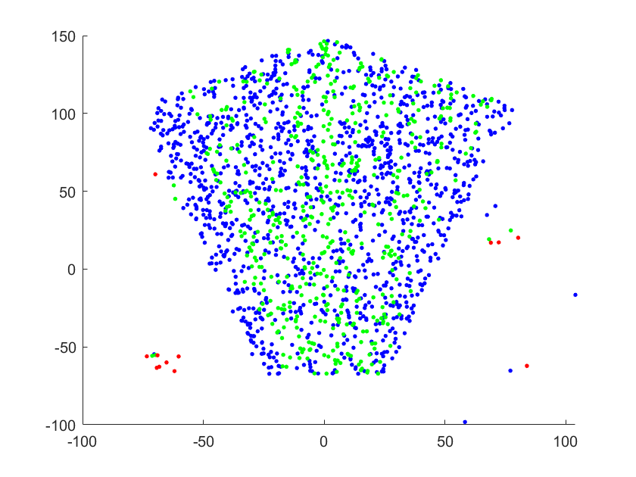
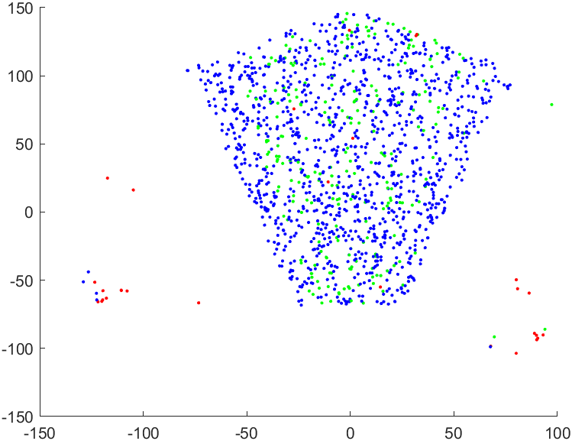
Results: Predicted Narrow Beam (1)
 | NN | SVM
Correct Beam Prediction | 80% | 80.4%
Neighbor Beam Prediction | 18% | 19.2%
Bad Beam Prediction | 2% | 0.4%
Cluster outliers are probably side lobes
Baseline vs Neural Network (Single UE)
Baseline vs SVM (Single UE)

Slide 16
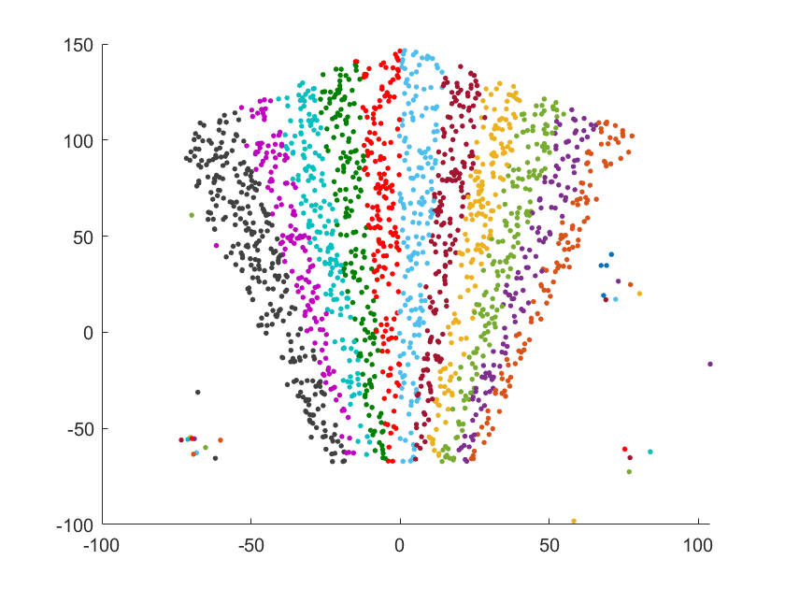
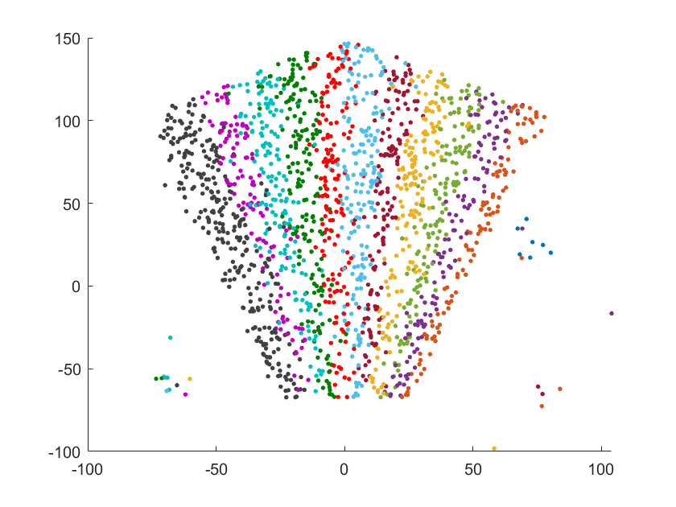
Results: Predicted Narrow Beam (2)
Baseline
Neural Network
Baseline vs Neural Network (Single UE)

Slide 17
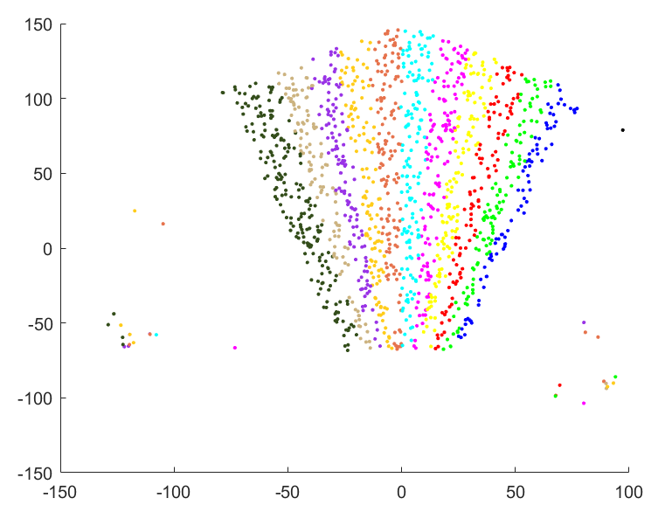
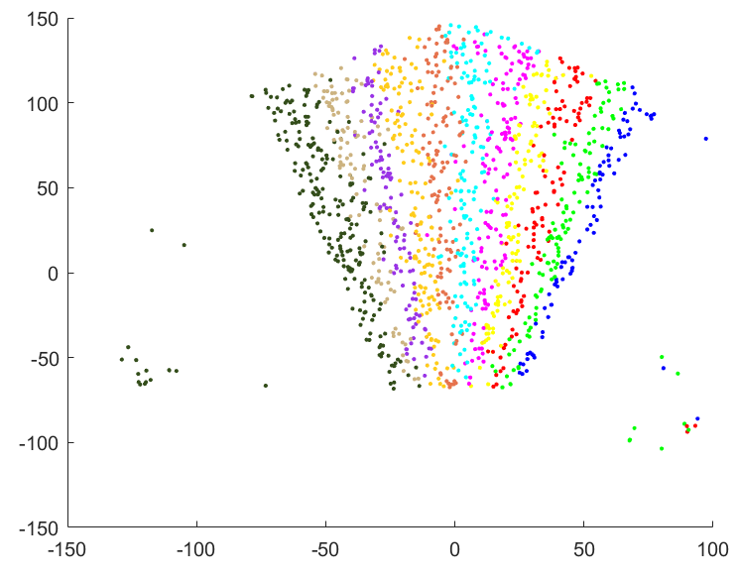
Results: Predicted Narrow Beam (2)
Baseline
SVM
Baseline vs SVM (Single UE)

Slide 18
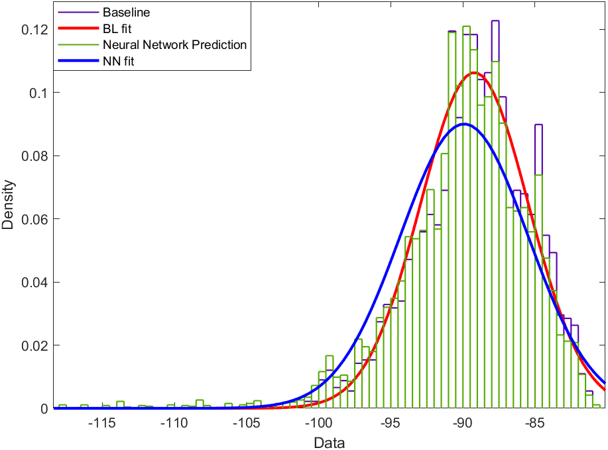
Results: RSRP distribution
Baseline vs Neural Network (Single UE)
Baseline vs SVM (Single UE)

Slide 19
Future scope
Consider non line of sight scenario.
Test for beam reflections.
Figure out way to handle side lobes using ML.

Slide 21
Backup Slide

